Slide 1

Difference in bike usage between customers and subscribers
Analysis by
Shawn Kelley

Slide 2
Purpose
Through analyzing the bike share data from Chicago determine how customers and subscribers utilize the bike share differently around Chicago.
Subscriber - Users who pay a monthly subscription for access to the service.
Customer - Users who pay each time the use the service.

Slide 3
Agenda
When are people using bike share and the difference in times between customers and subscribers.
Days of the week customers and subscribers use bike share.
Length of time customers and subscribers use their bikes when renting from the bike share.
Most popular routes taken by customers and subscribers.

Slide 4
Process
The data was sourced from Chicago’s divvy bike data set, specifically the Q1 data for both 2019 and 2020.
Cleaning the data was fairly simple, a few columns needed to have their names adjusted to make it easier to work with and make the columns more defined.
Performed basic analysis on the 2019 dataset, in sheets, to more closely resemble that of the 2020 dataset.
SQL was then used to analyze the data.
The results from the analysis were then imported to Sheets as pivot tables where visuals of the data were created.

Slide 5
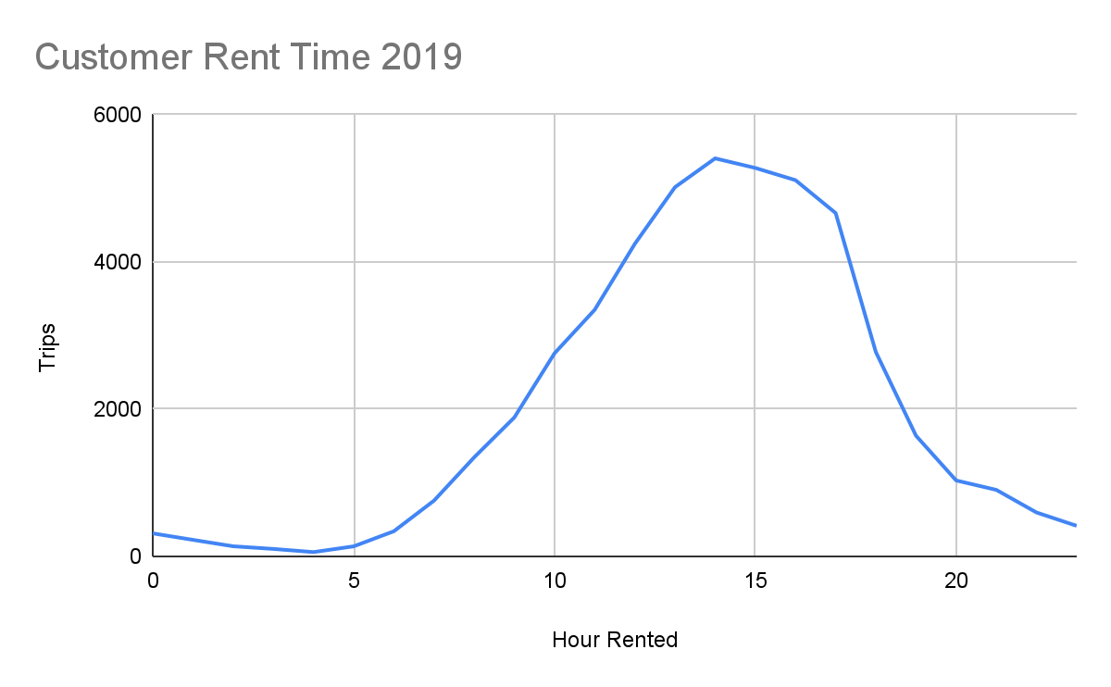
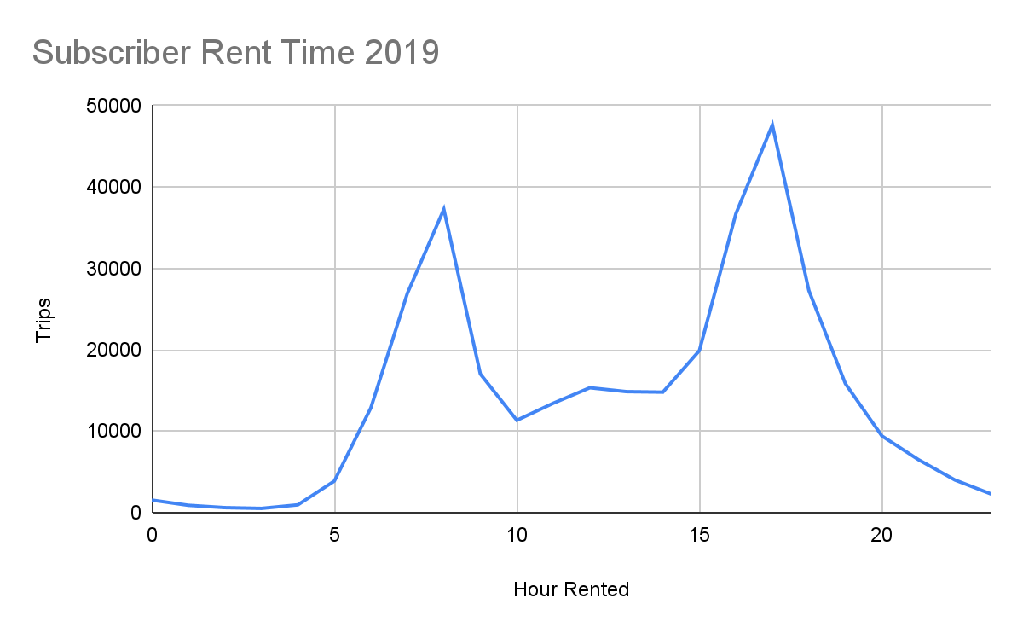
Times bikes were rented 2019
Subscribers to the city bike share are most likely to use them for commuting to and from work, as well as travel for lunch.

Slide 6
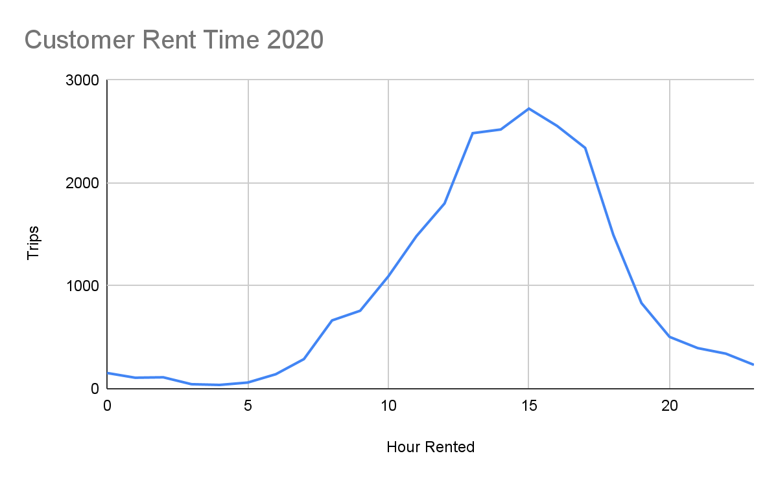
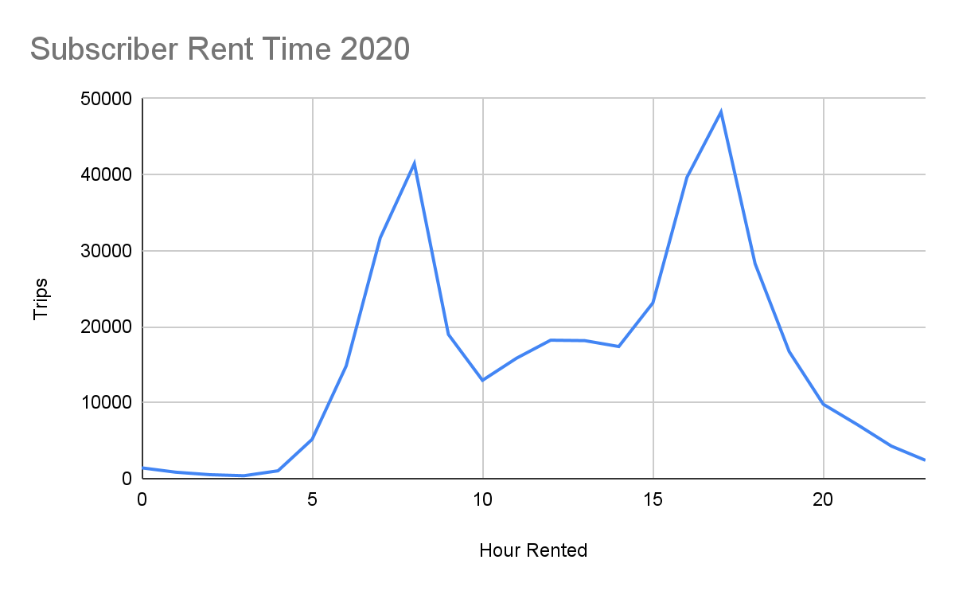
Times bikes were rented 2020
Non Subscribers are more likely to rent their bikes in the afternoon.

Slide 7
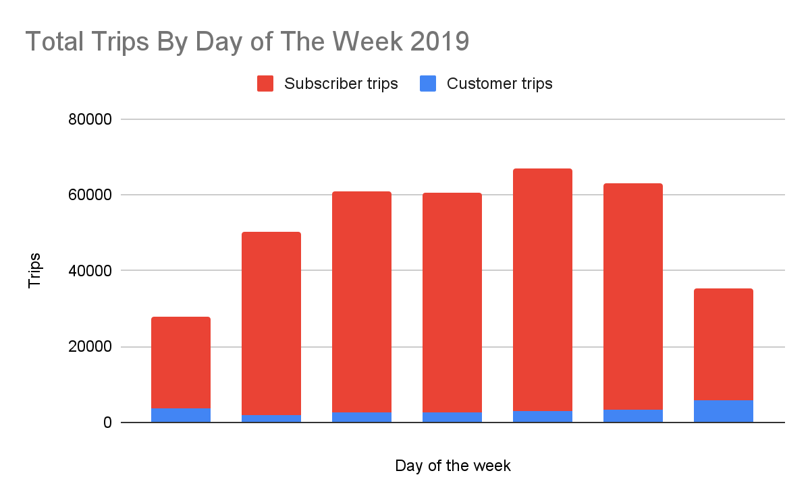
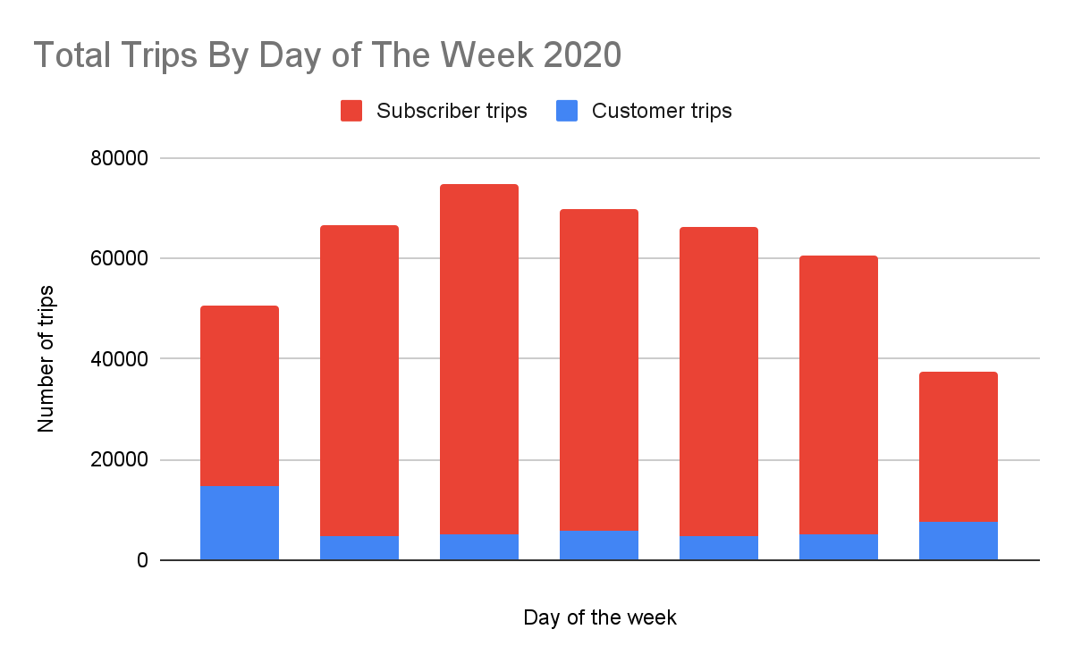
Total bikes rented per day
Subscribers use the bike share during the weekdays
Non-subscribers use the bike share more frequently on the weekends

Slide 8
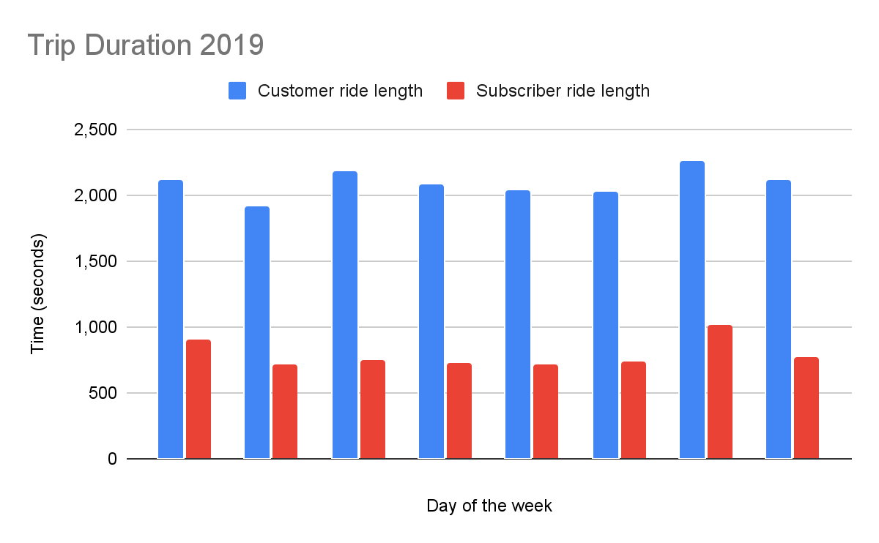
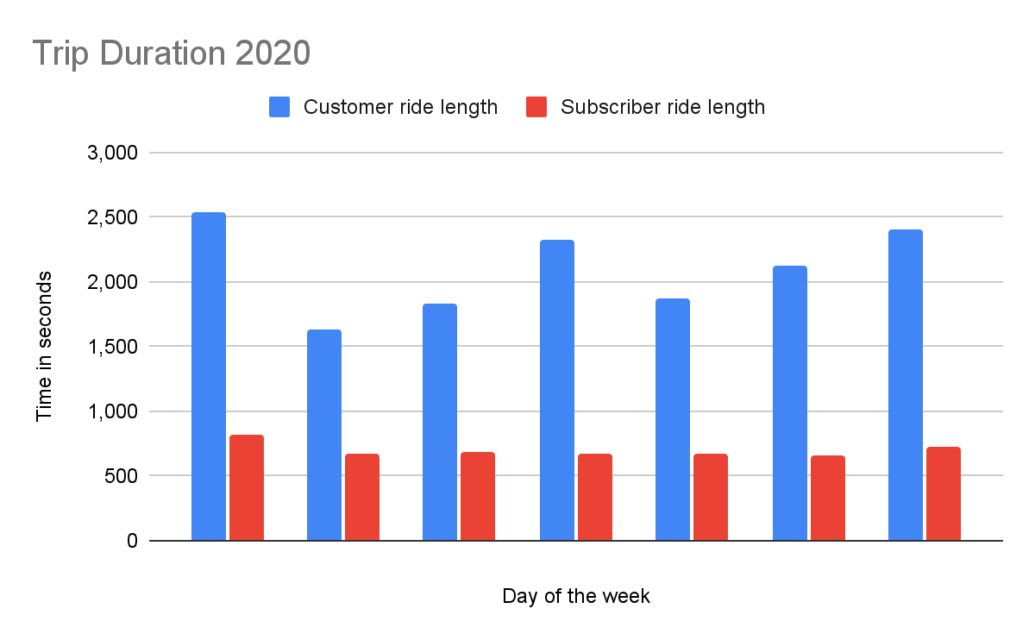
Average bike ride length
While subscribers rent more bikes than customers, customers ride the bikes for longer periods of time

Slide 9
Most Popular Routes for 2019
Subscribers typically go from one spot of downtown to another spot of downtown. The paths that subscribers take do not go near or on the lakefront
Subscribers
Customers
Michigan Ave & Washington St | Clinton St & Washington Blvd
Columbus Dr & Randolph St | Clinton St & Washington Blvd
Michigan Ave & Washington St | Canal St & Adams St
Canal St & Madison St | Michigan Ave & Washington St
Canal St & Adams St | Michigan Ave & Washington St
Lake Shore Dr & Monroe St | Streeter Dr & Grand Ave
Lake Shore Dr & Monroe St | Lake Shore Dr & Monroe St
Streeter Dr & Grand Ave | Streeter Dr & Grand Ave
Shedd Aquarium | Streeter Dr & Grand Ave
Shedd Aquarium | Millennium Park

Slide 10
Most Popular Routes for 2020
Customers are more likely to use the bikes to travel to a central location from various attractions in the city. The number one path is along the lakefront of the city. Most likely ending near Navy Pier
Subscriber
Customer
Canal St & Adams St | Michigan Ave & Washington St
Michigan Ave & Washington St | Clinton St & Washington Blvd
Ellis Ave & 60th St | University Ave & 57th St
University Ave & 57th St | Ellis Ave & 60th St
Canal St & Madison St | Michigan Ave & Washington St
HQ QR | HQ QR
Lake Shore Dr & Monroe St | Lake Shore Dr & Monroe St
Lake Shore Dr & Monroe St | Streeter Dr & Grand Ave
Shedd Aquarium | Streeter Dr & Grand Ave
Streeter Dr & Grand Ave | Streeter Dr & Grand Ave

Slide 11
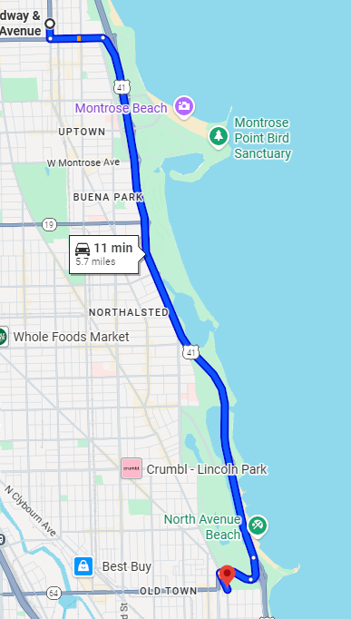
The Road Most Traveled
In 2020 this became the most frequently traveled route by customers who do not subscribe when they rent a bike on Sundays.

Slide 12
Conclusion
After analyzing the data we can see that customers are more likely to use the bike share for recreational activities in the afternoons.
Subscriber are most likely going to be people who use the bike share to commute to and from work and a few who use the bikes during their lunch hours.
There is no data for a user ID tag so we cannot track individual subscriber habits.
There is no financial data so we cannot track repeat customers.

Slide 13


Slide 14
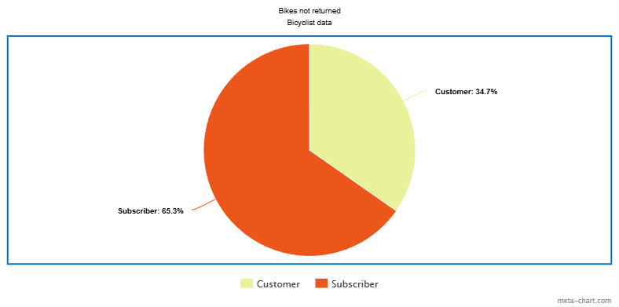
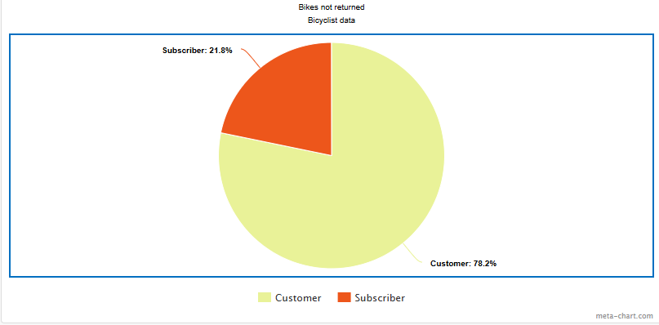
In 2019 subscribers were more likely to return their bikes to the depots, this flipped in 2020
2019
2020

